Slide 1






AI VIDYASETU 1.0 —
ZONALS PRESENTATION TEMPLATE
PROJECT/CODE TITLE : CLOTHSHARE
Team ID : B1144SR1
Team Name : KV BERHAMPUR SENIOR 1
Category : Senior
School Name & Region:
PM SHRI KENDRIYA VIDYALAYA BERHAMPUR (BBSR REGION)

Slide 2
2 Minute Video Demonstration Of Our Project
Understanding Of The Problem
Logic And Algorithm
Code Implementation
Demonstration Of Output
Challenges Faced
Solution Adopted
Conclusion
Table of Content

Slide 3
UNDERSTANDING OF THE PROBLEM
Clothes Share is a Web/Mobile app that solves textile waste by creating a digital catalogue , primarily for donation centers across the country to aid them in their proceedings.
Our platform offers:
Quick Donation: Easy form submission with photo, size, and condition details.
Secure Claiming: A dynamic catalogue with required contact confirmation for seamless pickup coordination.
AI Style Inspiration: Uses camera input and AI to suggest complementary items from the catalogue, maximizing clothing reuse.
Gamified Sustainability: Robust user tracking and points system to reward donation and engagement.
Clothes Share: Transforming unused clothes into shared, sustainable style, Eliminating Donation friction along with it.

Slide 4
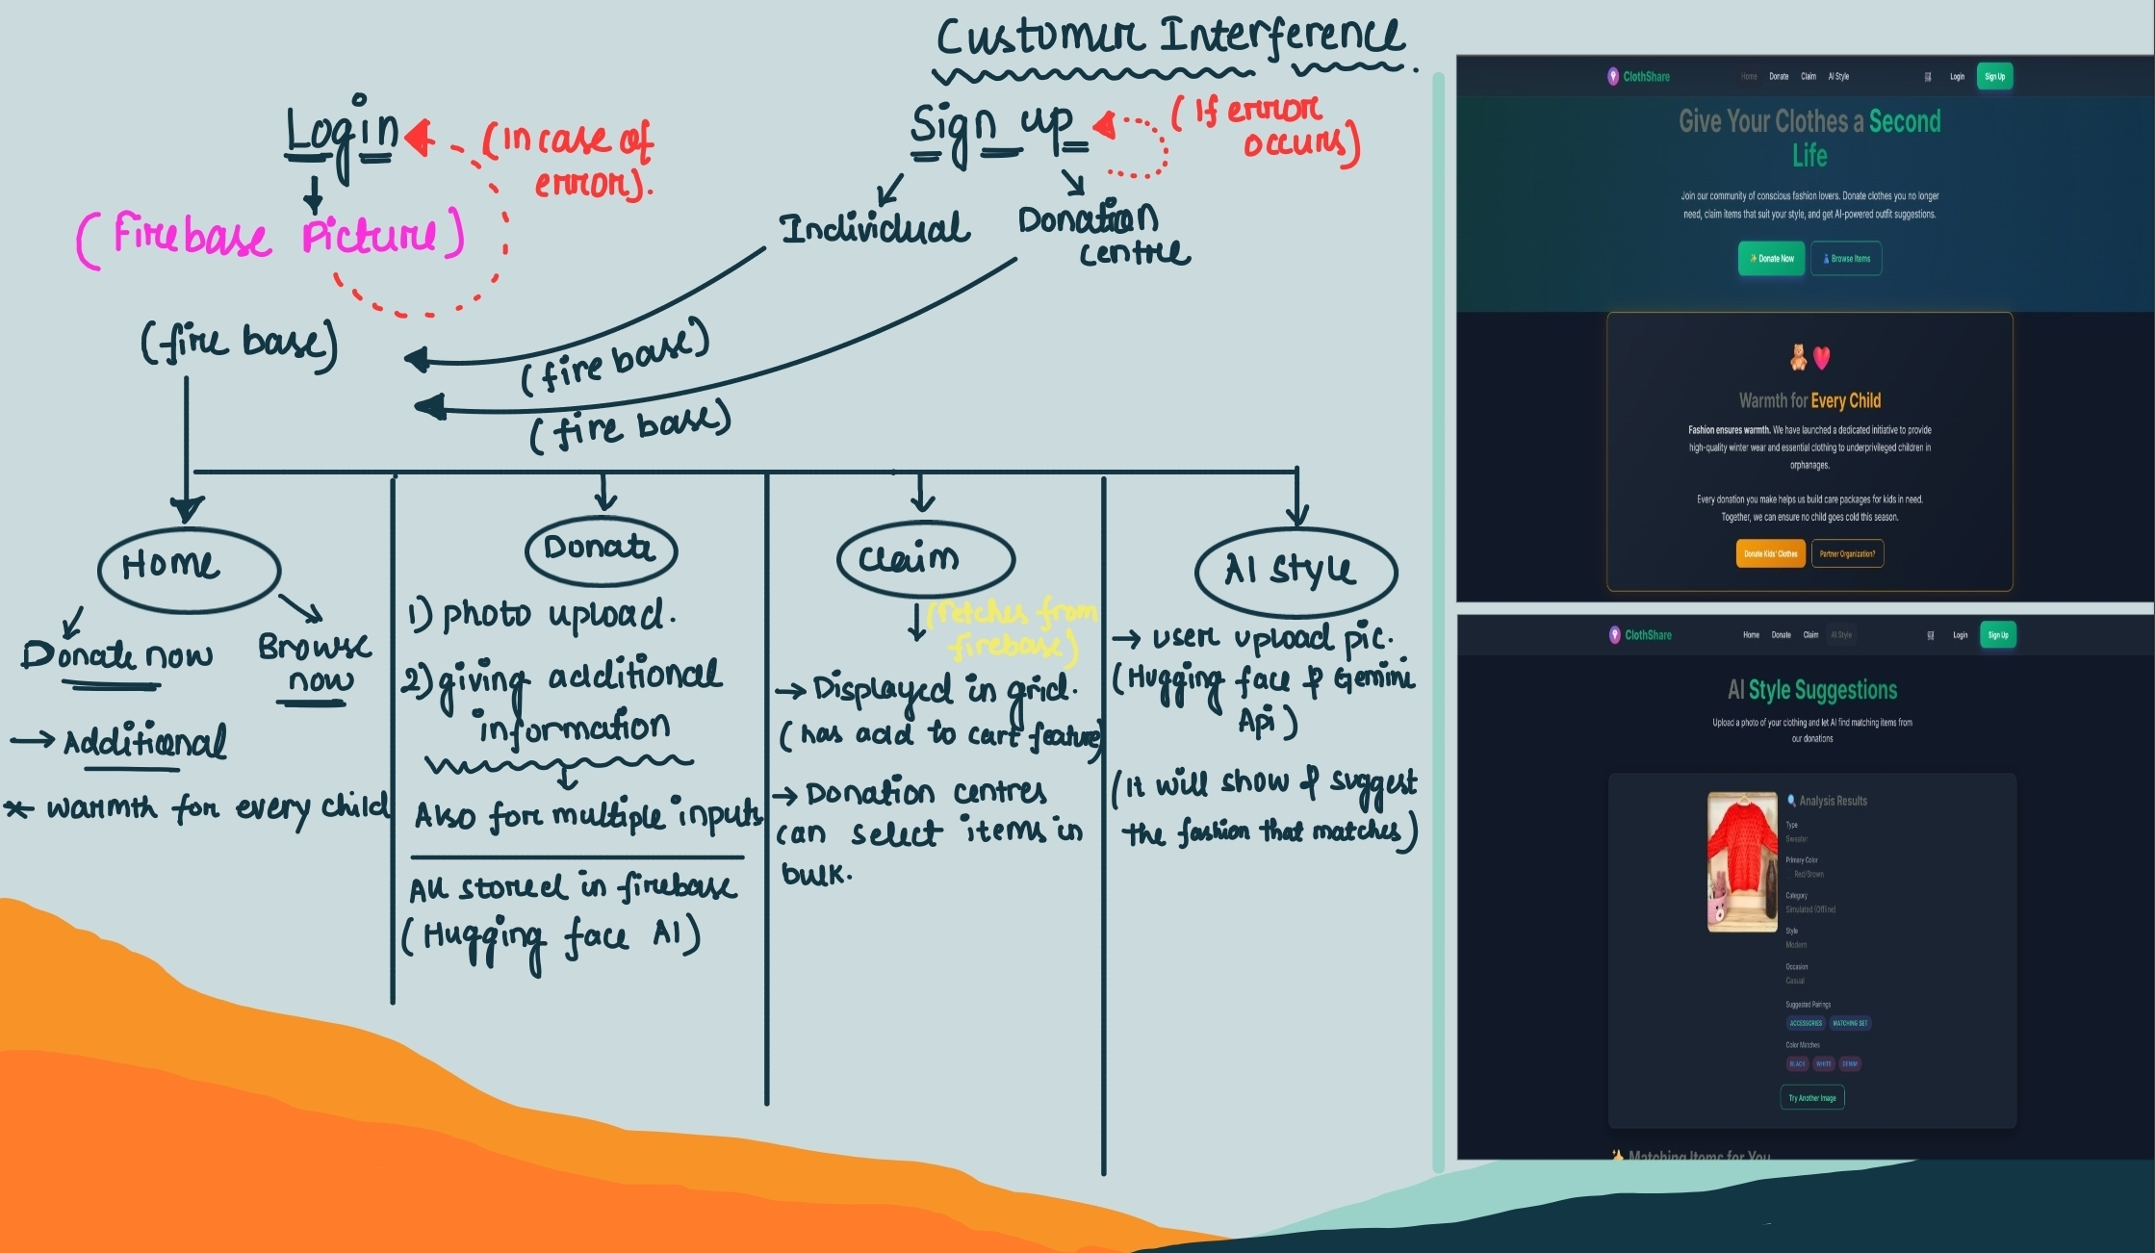

Slide 5
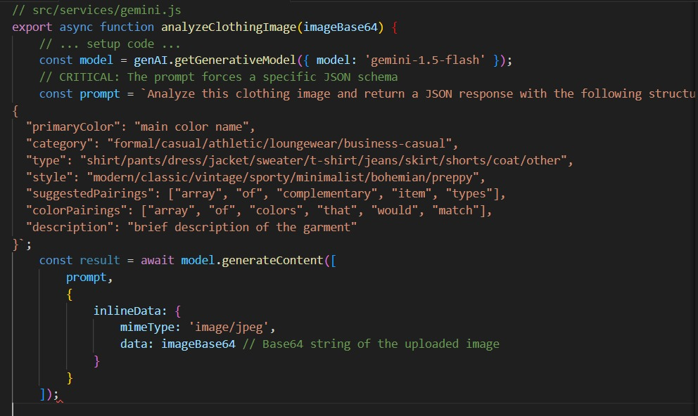
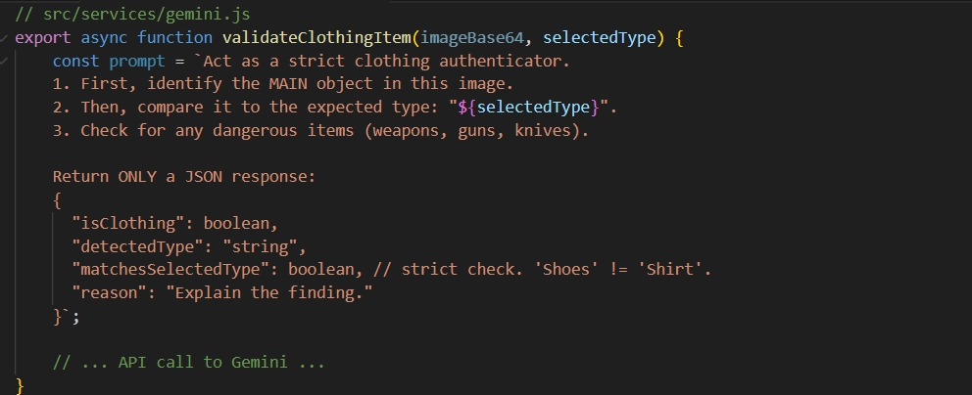
CORE CODE SNIPPETS
This snippet ensures users don't upload random pictures (like a toaster) to the clothing donation platform.
It sends the image to Google Gemini with a structured prompt to force a JSON response

Slide 6
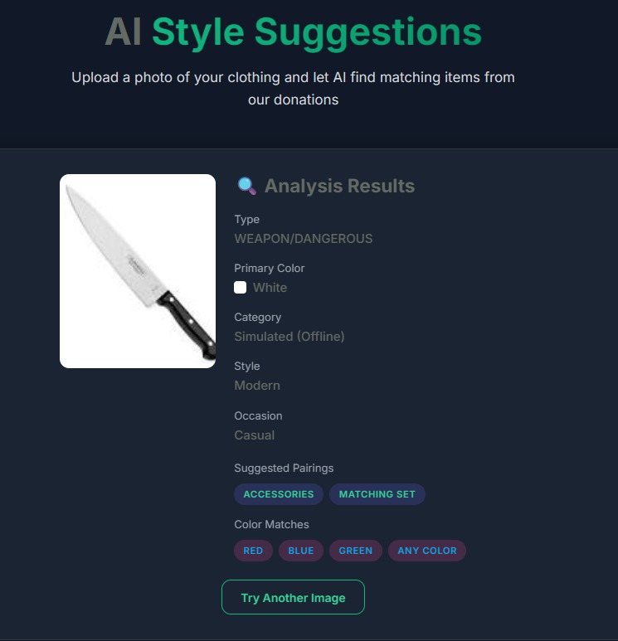
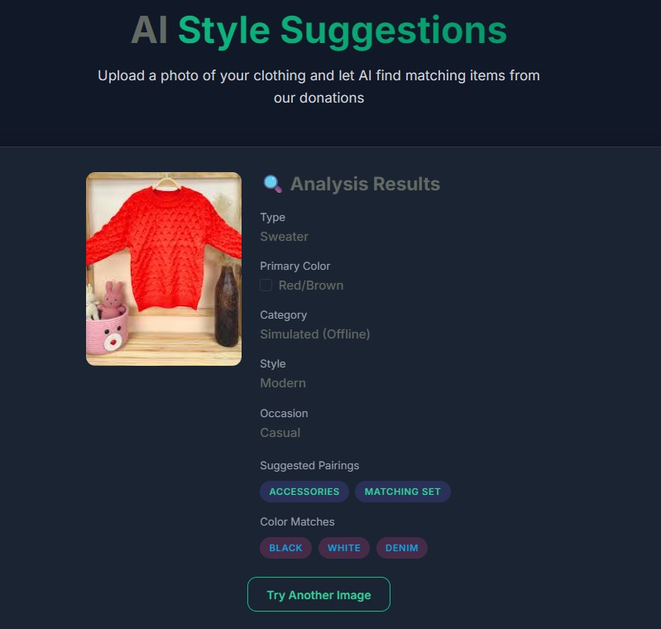
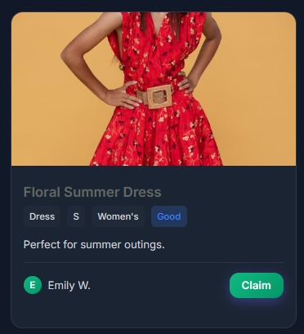
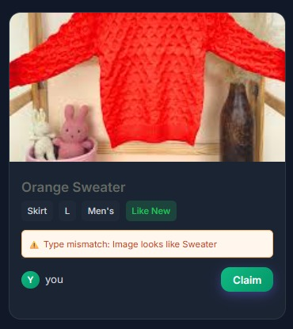
DEMONSTRATION OF OUTPUT

Slide 7
CHALLENGES FACED
Technical: Integrating the AI Vision API for accurate garment and color identification was difficult, as was managing the real-time dynamic updates across the catalogue without performance lag.
Logical: Designing fair logic to prevent "claim sniping" (bots claiming items instantly) and properly balancing the gamified points system to favor donation were key hurdles.
Debugging: The most complex debugging related to asynchronous race conditions—ensuring the database correctly handled simultaneous claim attempts on the same item with transaction locking.

Slide 8
SOLUTION IMPLEMENTED
Solutions Adopted
Used Hugging Face API for quick and accurate garment identification.
Used Gemini 3 Pro for complex reasoning, color interpretation, and structured JSON outputs.
Developed and tested the workflow in our Anti Gravity code editor, ensuring clean, modular, and well-structured code.
Used Firebase transactions and real-time sync to prevent double-claiming and maintain a smooth, consistent catalogue.
Alternative Methods Explored
Tried YOLO models for on-device detection but were too resource-heavy.
Tested AWS Rekognition and Supabase, but Firebase + Gemini gave better accuracy and integration.
Considered local vector search for style-matching but dropped due to time constraints.
Learning & Improvements Made
Gained strong understanding of AI Vision APIs, prompting, and JSON responses.
Learned Firebase (storage, auth, realtime updates, transactions).
Improved debugging, API integration, teamwork, and workflow planning.

Slide 9
CONCLUSION
Our project successfully combined AI-powered image recognition with a real-time donation catalogue to make clothing reuse easier and more sustainable. By integrating advanced APIs and Firebase, we built a reliable system that reduces textile waste, simplifies donations, and encourages responsible community participation.

